Slide 1
Building Machine Learning Models
For
Wine Types Classification
Group-7
Sreekar T-11636306
Srinivas S-11667743

Slide 2
Introduction
Explores about the machine learning models such as : Decision tree, Random forest, Support Vector Machine(SVM) to classify the wines.
Objective is to predict the wine types
To distinguish the performance of different type of wine by training and evaluating the models.

Slide 3
Problem Statement/Hypothesis
Problem statement
We intend to develop reliable machine learning models to categorize wines into three groups based on chemical analysis parameters.
Hypothesis
It is expected that the models such as Decision Tree, Random Forest, and Support Vector Machine (SVM) models would be able to efficiently categorize the wines based on their chemical properties.

Slide 4
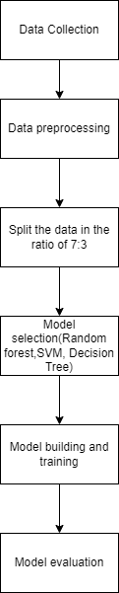
Methodology

Slide 5
Architecture of Models Used
Decision tree classifier
Random Forest
Support Vector Machine

Slide 6
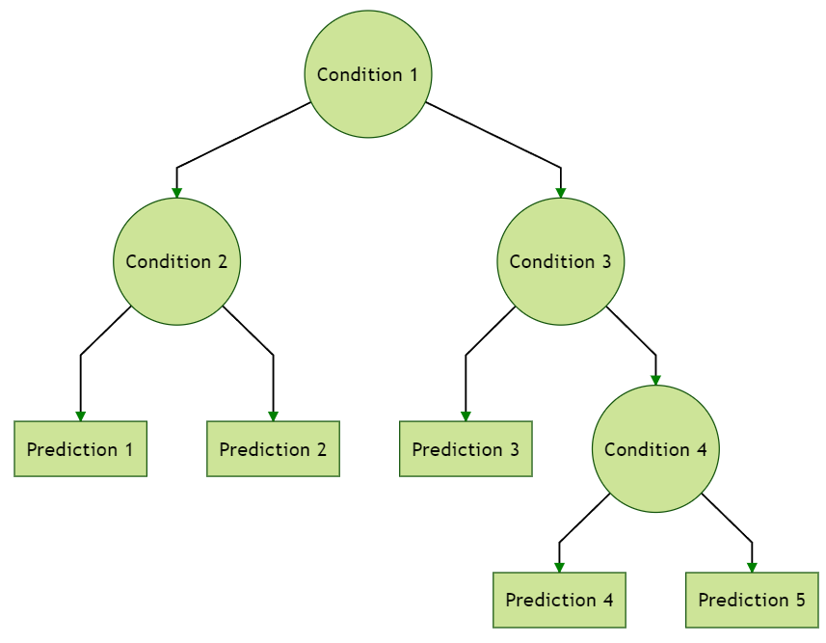
Decision tree Classifier
Decision Tree(is a tree-like model that recursively separates data into classes based on characteristics.
It selects optimal features and thresholds at each node to reduce defect (for example, Gini impurity or entropy).
Decision Trees are simple and interpretable, suitable for classification and regression tasks.

Slide 7
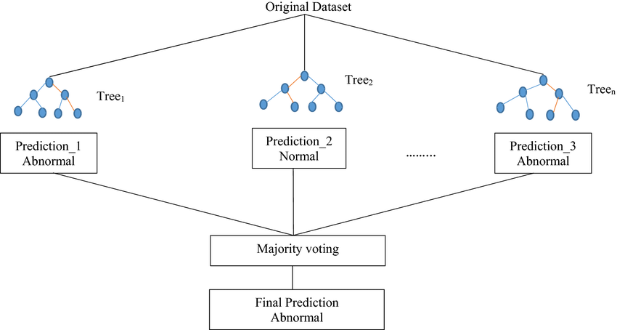
Random Forest Classifier
Random Forest is made up of many decision trees (estimators) that each generate their own forecasts.
Every tree has been taught on an arbitrary portion of the training data and takes just a randomized sample of characteristics into consideration at every split.
Random Forest lowers overfitting, enhances generalization, and becomes less susceptible to noise and outliers by aggregating predictions.

Slide 8
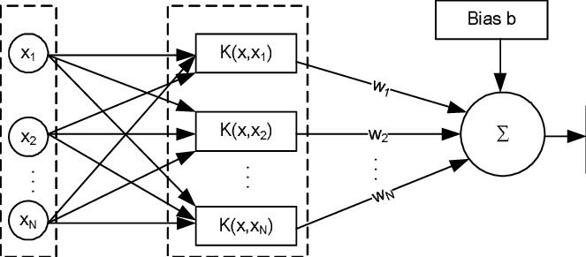
Support Vector Machine
By maximizing the margin between support vectors, SVM determines the best hyperplane to split classes.
Support vectors are data points that define the location of the hyperplane and are nearest to it.
SVM is capable of handling simultaneously linear and nonlinear data by using kernel functions such as linear, polynomial, and radial basis.

Slide 9
Dataset
Description:
The dataset used is Wine dataset (scikit-learn developers) which is popular dataset for classification task.
Includes chemical analysis attributes for three different types of wines (classes).
total of 178 occurrences (samples) in the dataset.
Each instance includes 13 characteristics that reflect various chemical qualities, and the target variable is made up of three classes that represent distinct wine varieties.

Slide 10
Design of features/Labels
Features:
The features of the dataset are Alcohol, Malic Acid, Ash, Alcalinity of Ash, Magnesium, Total Phenols, Flavanoids, Nonflavanoid Phenols, Proanthocyanins, Color Intensity,Hue,OD280/OD315 of Diluted Wines, Proline.
Labels:
Class 0: Wines of type 0
Class 1: Wines of type 1
Class 2: Wines of type 2
The features reflect distinct chemical aspects of the wines, while the labels identify the sort of wine to which each instance belongs. These characteristics will be utilized to train the wine categorization models.

Slide 11
Data Preprocessing
Process to convert the Raw data to machine readable data.
Includes data cleaning, data integration, data reduction, and data transformation.
Wines data is cleaned out by dropping null values.

Slide 12
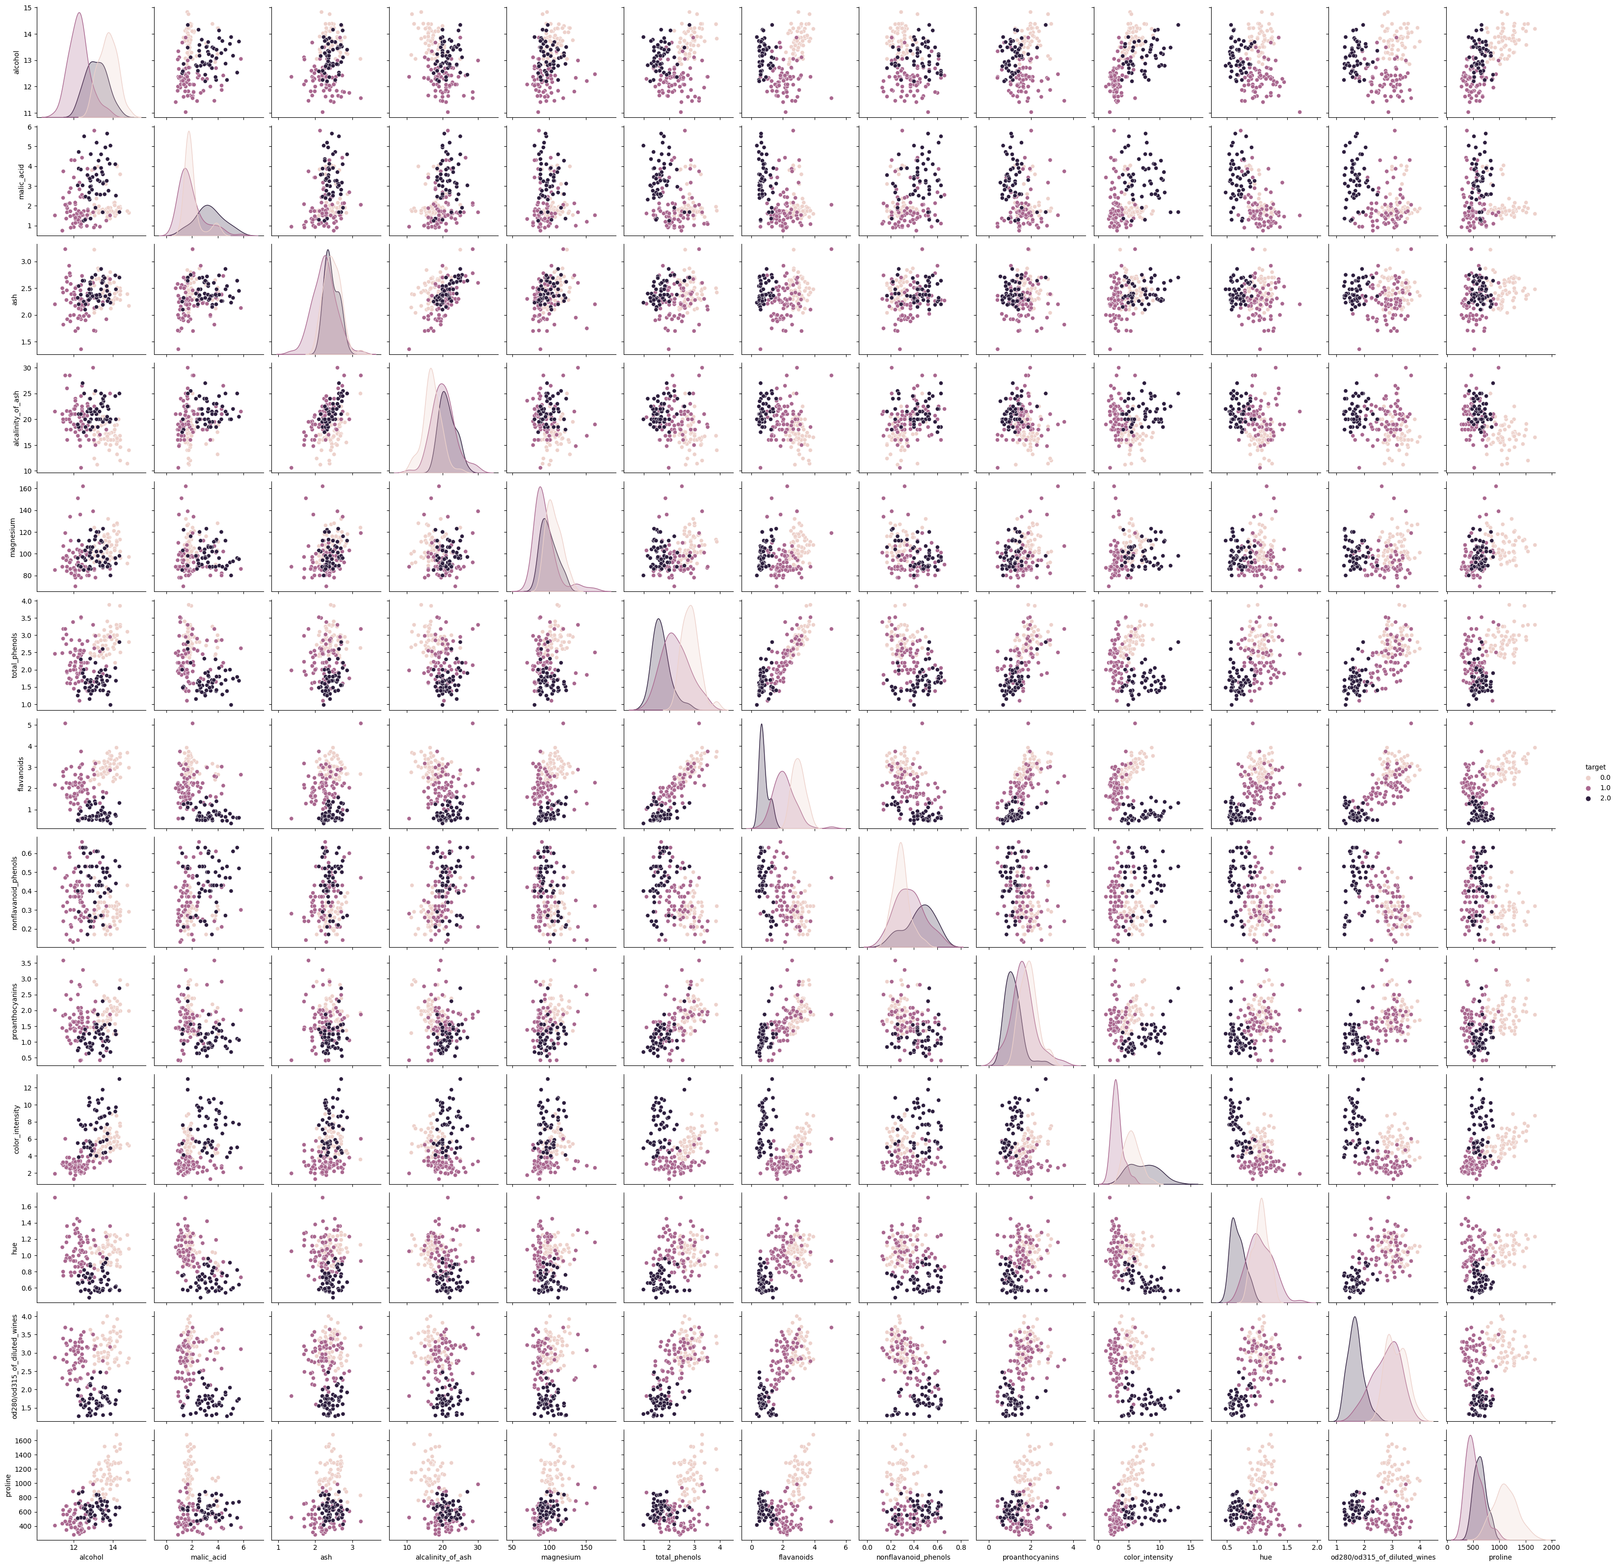
Exploratory Data Analysis
Pair plot for visualizing the relationship between different pairs of features

Slide 13
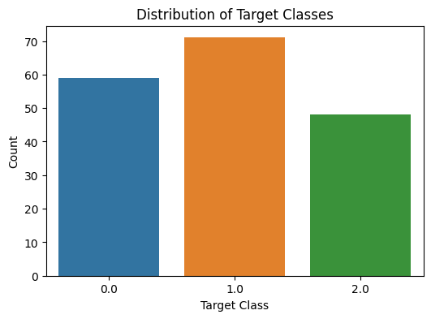
Distribution of target classes

Slide 14
Implementation
Algorithm
Decision Tree Classifier:
Initialize tree.
Choose the most suitable characteristic as well as threshold for every node in order to split the data based on impurity.
Make the split's left and right child nodes.
Random Forest Classifier:
Initialize empty list for trees.
For each tree, create a random subset of data and features.
Build decision tree with selected data and features.
Aggregate predictions through voting (classification) or averaging (regression).
Support Vector Machine (SVM):
Initialize hyperplane parameters.
For each data point, adjust hyperplane to classify correctly.
Repeat until convergence or maximum iterations reached.

Slide 15
Implementation Libraries
NumPy
Pandas
scikit-learn
Matplotlib.pyplot
Seaborn

Slide 16
Explanation of implementation
The Wine dataset was used to train and assess three machine learning models (Decision Tree, Random Forest, and Support Vector Machine) in this implementation.
The data was divided into 7:3 training and testing sets, and features were optionally standardized.
Each model was initialized, trained on the training data, and used to make forecast based on the test data.
Model evaluation was done using accuracy scores and confusion matrix

Slide 17
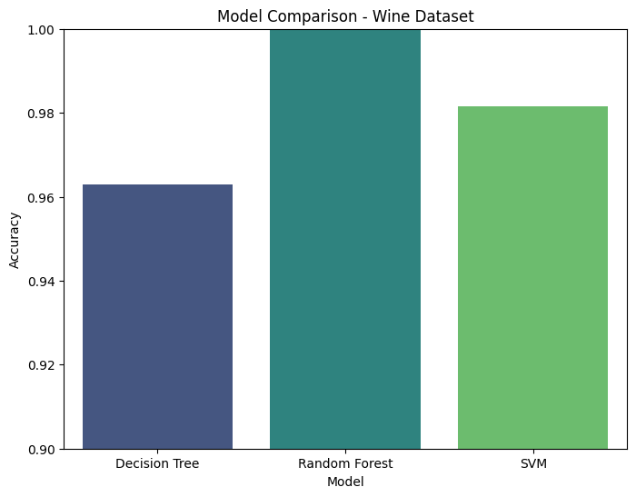
Results
Decision Tree Accuracy: 0.96
Random Forest Accuracy: 1.0
SVM Accuracy: 0.98

Slide 18
Implementation status Report
Work completed:
Successfully implemented machine learning models(Decision Tree, Random Forest, and SVM) for wine classification.
Description:
Involved building and training three different classifier on dataset into three classes.
Responsibility(Task, Person):
Data Preprocessing and Model Implementation (Decision Tree, Random Forest, SVM): Sreekar Thanda
Model Training and Evaluation and Visualization and Reporting: Srinivas Sanku
Contributions:
Srinivas Sankula : 50%
Thanda Sreekar : 50%
Issues/Concerns:
Class imbalance
Dataset inconsistence

Slide 19
Conclusion
All models performed well in classifying wines based on chemical analysis attributes. Random Forest achieved the highest accuracy (100%), outperforming Decision Tree (96%) and SVM (98%).

Slide 20
References
Anshul Saini. “Guide on Support Vector Machine (SVM) Algorithm.” Analytics Vidhya., 2023, https://www.analyticsvidhya.com/blog/2021/10/support-vector-machinessvm-a-complete-guide-for-beginners/%0A.
JavaTpoint. “Decision Tree Classification Algorithm.” JavaTpoint., 2021, https://www.javatpoint.com/machine-learning-decision-tree-classification-algorithm.
Niklas Donges. Random Forest: A Complete Guide for Machine Learning. 2023, https://builtin.com/data-science/random-forest-algorithm.
scikit-learn developers. “Sklearn.Datasets.Load_wine.” Scikit-Learn Developers, 2023, https://scikit-learn.org/stable/modules/generated/sklearn.datasets.load_wine.html%0A.

Slide 21
THANK YOU

